Slide 1
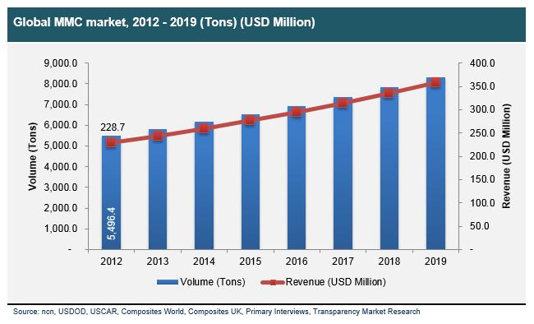

Composites for thermal management
Unit 6-2
Thermal management

Slide 2
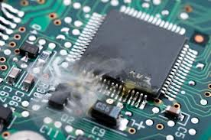
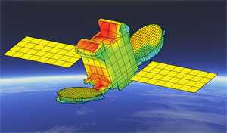
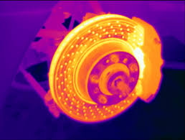
Composites for thermal management
Topics - requirements on thermal management materials (examples)
- heat conductivity range in metals and non-metals
- examples of composite for applications
disk brakes
power electronics
micro-electronics
powerlines
space telescope
Goals - understanding the principles of thermal properties of composite materials, i.e. design of composites with tailored thermal properties

Slide 3
Composites for thermal management
TIM
heat source
FGM
n
p
Q
TE
FGM
e⁻
h⁺
I
I
TIM
heat sink
MMC
NF
TIM thermal interface material
FGM functionally graded material
TE thermoelectric element
MMC metal matrix composite
NF nanofluid

Slide 4
Relevant materials properties in thermal management:
Thermo-physical:
coefficient of thermal expansion (CTE)
thermal conductivity (TC)
thermal diffusivity (not in CES)
heat capacity
Other (application specific): density, wear resistance, stiffness, machinability, etc…

Slide 5
Thermal management materials
Quiz
thermal conductivity in W/mK of selected (pure) materials
metals
Mg 12 156 216
Al 65 237 392
Ti 26 130 412
Cu 98 283 401
Ag 156 429 650
non-metals
Al₂O₃ 5 25 125
carbon 5 900 2200
SiC 80 300 490
AlN 100 180 260
water 0.6 16 60
air 0.025 0.25 2.5
vacuum 10⁻⁶ 10⁻³ 10⁻¹
stainless steel (FeCrNi) ?
values @ room temperature
FeCrNi: ca. 16 W/mK (Typ 304, 316)
Notes:
FeCrNi: ca. 16 W/mK (Typ 304, 316)

Slide 7
Examples of aluminium composites for thermal management

Slide 8
Transportation: brake discs
Aluminium composites for transportation applications : break discs
Requirements:
Wear resistant
Corrosion resistant
Light weight
Heat dissipation
Low cost

Slide 9

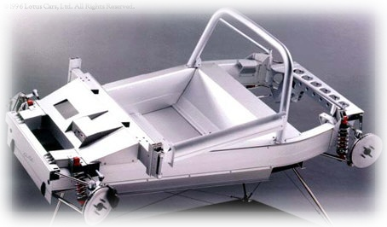
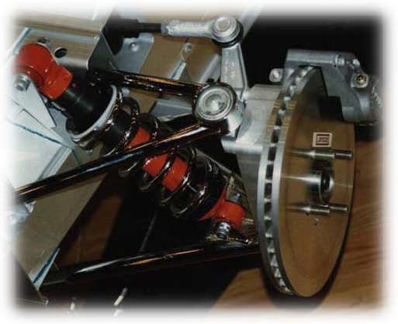
brake discs and drums for automotive applications
source: Lotus Cars Ltd.
Brake discs (front & rear)
material: MMC - AlSiMg/SiC/30p (Lanxide)
MMC: therm. cond. 160 W/mK
Tmax 380°C (Stelvio-Pass)
weight (of complete car): ≈ 700 kg
ca. 1996

Slide 10
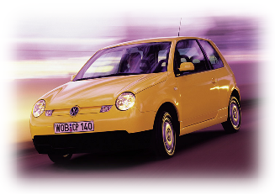
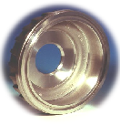
brake discs and drums for automotive applications
ca. 1999
VW-Lupo (Tdi) – brake drum
material: MMC - A359/SiC/20p
weight: 1.55 kg
materials costs: < 5 US-$ / kg
source: VW

Slide 11
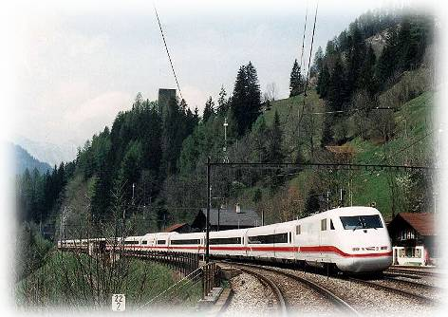
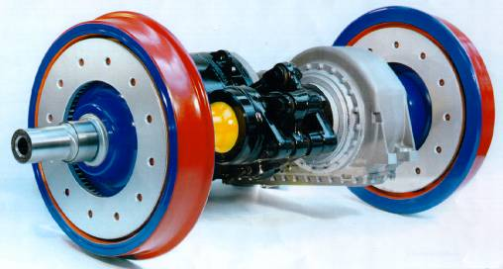
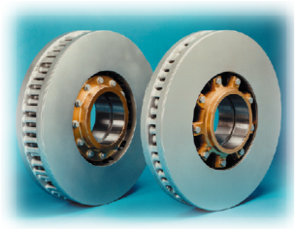
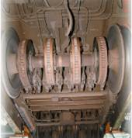
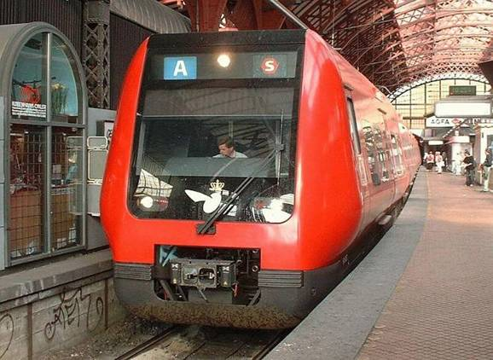
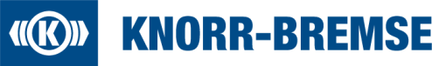
Aluminium brake discs for railway applications
ICE
Copenhagen Suburban
Notes:
Bremsscheiben (und Bremstrommeln) für den Einsatz in der Fahrzeugtechnik werden heute weitestgehend aus Grauguss gefertigt. Dies ist wohl eine wirtschaftliche, dennoch aus Sicht des Ingenieurs nicht optimale Lösung, wenn man bedenkt, dass
- es sich dabei um ungefederte, rotierende Massen handelt und die Dichte von Grauguss über 7 g/cm³ beträgt,
- beim Bremsen lokal hohe Wärmedichten entstehen, die es möglichst effizient zu dissipieren gilt, wobei die WLF von Grauguss unter 50 W/m K liegt,
- Bremskomponenten widrigsten Witterungsbedingungen ausgesetzt sind und Grauguss nicht besonders korrosionsfest ist und
- der Verschleiß hoch ist, aber Grauguss nicht übermäßig verschleißfest ist.
Eine Substitution von Grauguss durch einen Al-MMC (Dichte unter 3 g/cm³ und WLF nahe 200 W/m K) ist in diesem Zusammenhang also nahe liegend, wobei die geforderte Verschleißfestigkeit durch die Keramikverstärkung gewährleistet wird. Für diese Anwendung haben sich SiC-Partikel verstärkte Aluminium MMC (PRM) als optimale Lösung erwiesen. In der Regel wird eine AlSiMg-Gusslegierung als Matrix eingesetzt (z. B. die Legierung A 359), welche durch Einrühren mit etwa 20 Vol.-% SiC-Partikeln versetzt wird; die Bremsscheiben oder -trommeln werden anschließend gießtechnisch im Sandguss, Kokillenguss oder Druckguss endkonturnah gefertigt.
Knorr-Bremse Deutschland, einer der weltweit führenden Hersteller von Bremssystemen für Schienen- und Nutzfahrzeuge, setzt auf Bremsscheiben aus Al/SiC-MMC (Abb. 3.12). Seit 1997 bietet das Unternehmen serienmäßig SiC-Partikel verstärkte Aluminium-Bremsscheiben an, die inzwischen beispielsweise in der S-Bahn Kopenhagen, den Straßenbahnen Oslo oder Stuttgart genauso Eingang gefunden haben wie in der Münchener U-Bahn oder dem KCRC Hongkong-Nahverkehrszug (IDR 2003). Auch für Güterzüge im alpenquerenden Verkehr und für den ICE der Deutschen Bahn wurden diese Bremsscheiben getestet. Gegenüber den Grauguss-Ausführungen lassen sich mit MMC pro Scheibe Gewichtsreduktionen von bis zu 75 kg (ca. 40 - 50 %) erzielen. Bei der Ausrüstung von ganzen Zugkompositionen und -flotten mit MMC-Bremsscheiben können gleich mehrere Tonnen an Gewicht und letztendlich auch erhebliche Energiemengen und -kosten eingespart werden. Mit vergleichbarer Argumentation werden zur Zeit MMC-Bremsscheiben auch für den Einsatz in LKWs evaluiert.

Slide 12
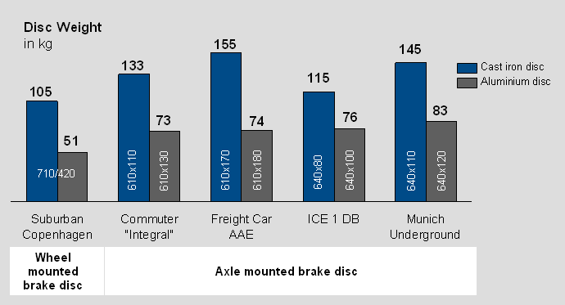
Al brake discs for railway applications
Advantage 1: weight saving

Slide 13
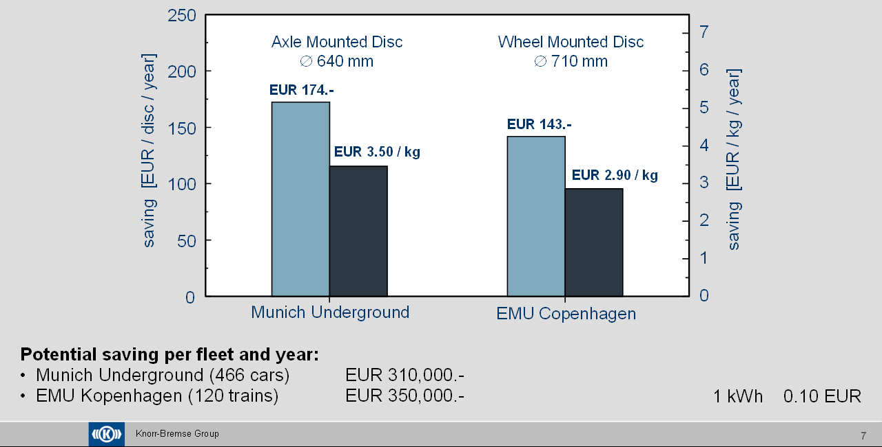
Al brake discs for railway applications
Advantage 2: energy & cost savings due to low weight

Slide 14
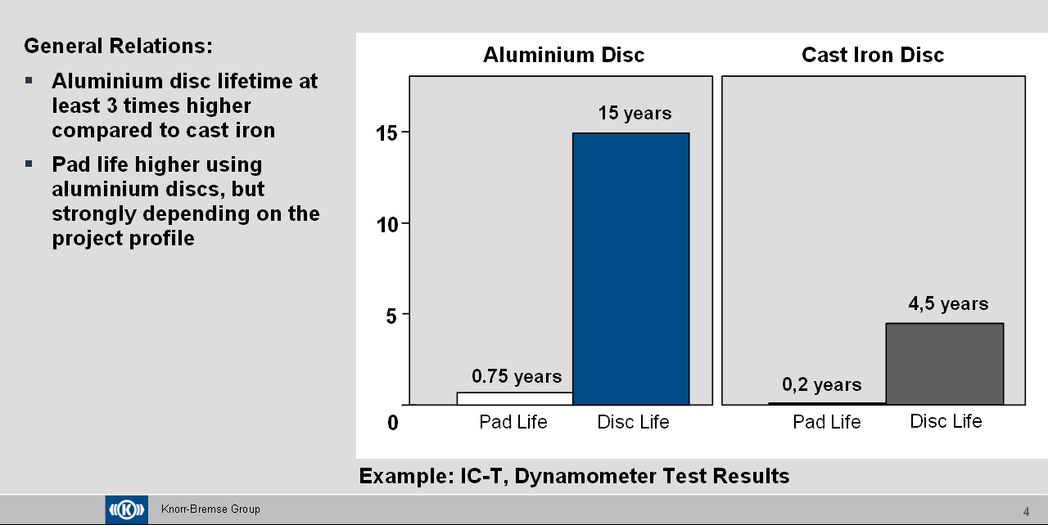
Al brake discs for railway applications
Advantage 3: increased lifetime of pads and discs

Slide 15
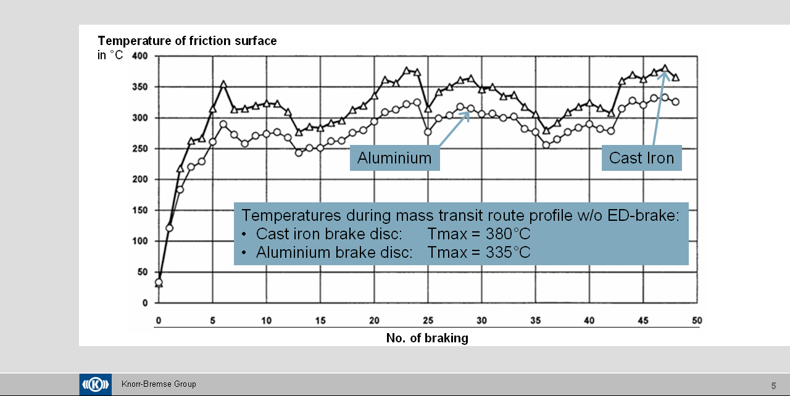
Al brake discs for railway applications
Advantage 4: Better Thermal Conductivity of Aluminium

Slide 16
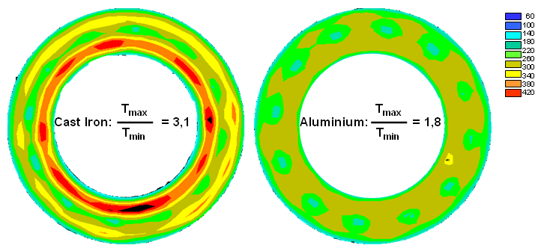
Al brake discs for railway applications
Local Disc Surface Temperatures: Comparison Cast Iron and Aluminium
materials requirements:
Al-alloy + SiC particles
⇒ MMC: A359/SiC/20p
high thermal conductivity
low density
high wear resistance
high corrosion resistance

Slide 17
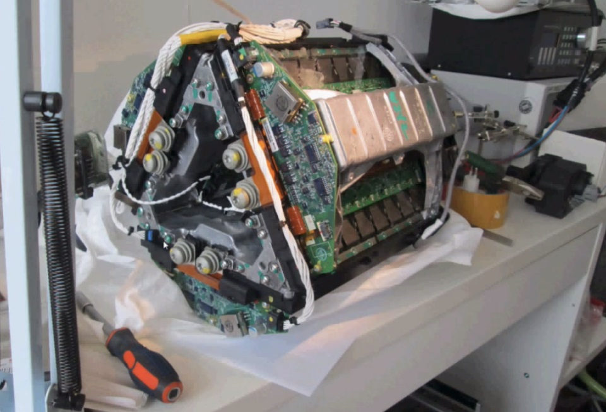
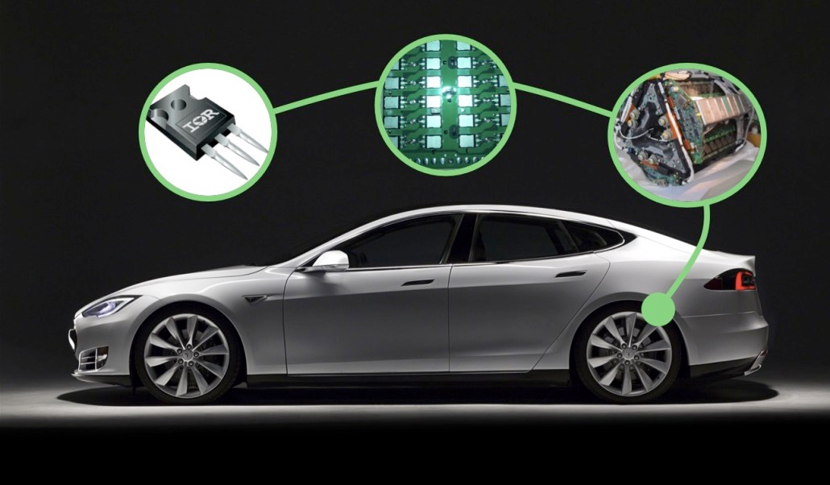
Aluminium composites for high power electronic applications: insulated-gate bipolar transistor (IGBT)
Conversion AC to DC and/or DC to AC in:
Traction (trains, subway systems electric car), and electric vehicles where power is generated by conventional motors, and power is recovered from breaking
Power generation (wind energy, hydroelectric)
Tesla Model S inverter – 3 phases represented by the triangle, having each two switches of 14 IGBTS in parallel

Slide 18
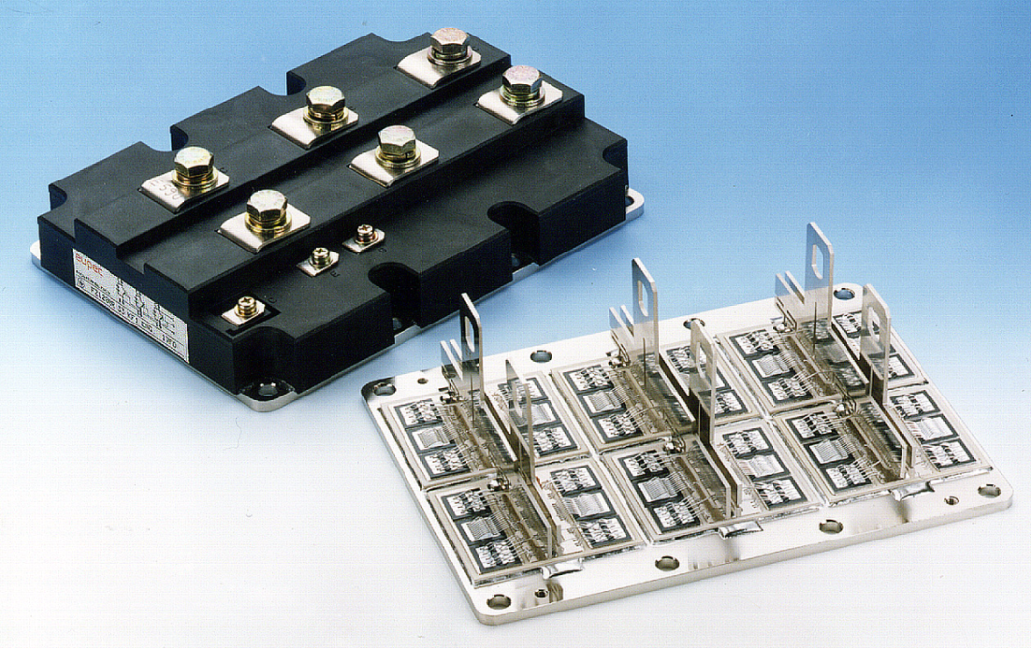
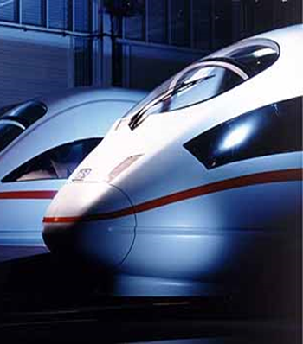

power-electronic applications
Heatspreaders in Powerelectronics
IGBT-Module
Bond Wire
CTE [ppm/K]
Solder
4.2
Si
Si
Si
Copper
Al₂O₃ or AlN Insulation
6.7 / 4.4
Grease
Cu or Al Heat Spreader
17 / 23.5
Cooler
Heat
17 / 23.5
by courtesy of ABB Semiconductors
Notes:
The transistor is a solid state semiconductor device which can be used for amplification, switching, voltage stabilization, signal modulation and many other functions. It acts as a variable valve which, based on its input current (BJT) or input voltage (FET), allows a precise amount of current to flow through it from the circuit's voltage supply.
The Insulated (or sometimes called Isolated) Gate Bipolar Transistor combines the simple gate drive characteristics of the MOSFET with the high current and low saturation voltage capability of bipolar transistors by combining an isolated gate FET for the control input, and a bipolar power transistor as a switch, in a single device.
The IGBT is a recent invention. The "first-generation" devices of the 1980s and early '90s were relatively slow in switching, and prone to failure through such modes as latchup and secondary breakdown. Second-generation devices were much improved, and the current third-generation ones are even better, with speed rivalling MOSFETs, and excellent ruggedness and tolerance of overloads. The IGBT is mainly used in switching power supplies and motor control applications.
Availability of affordable, reliable IGBTs is a key enabler for electric vehicles and hybrid cars. Toyota's second generation hybrid Prius has a 50 kW IGBT inverter controlling two AC motor/generators connected to the DC battery pack.
Retrieved from "http://en.wikipedia.org/wiki/IGBT_transistor"

Slide 19
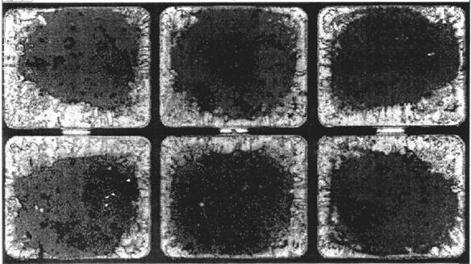
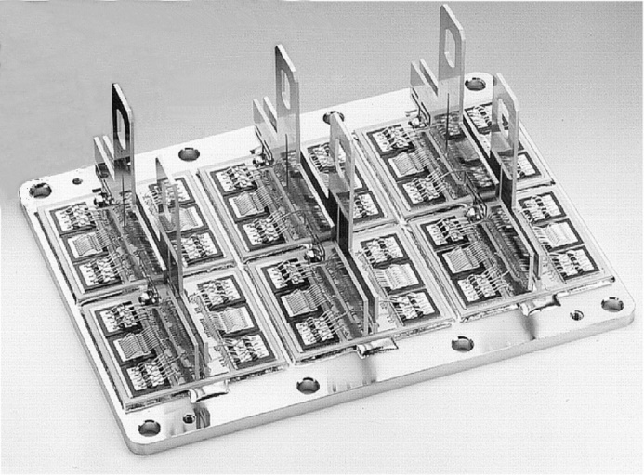
IGBT Failure: Solder Joints Fatigue
CTE mismatch between the components induces partial delamination after thermal cycles.
AlN
Cu
Al, Cu or AlSiC
Defective solder interface between ceramic & Cu base plate

Slide 20
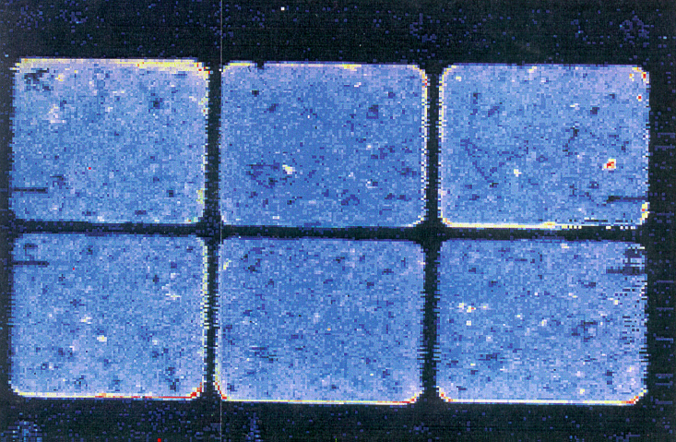
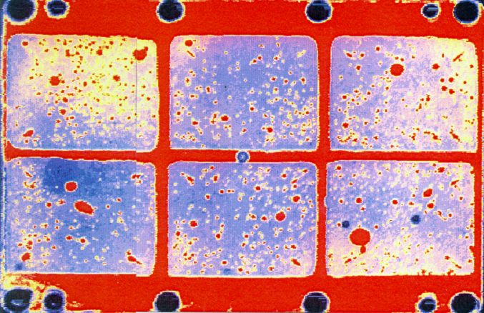
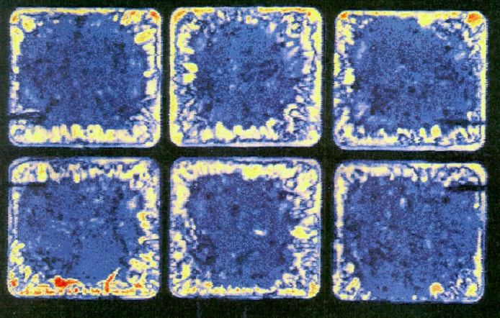
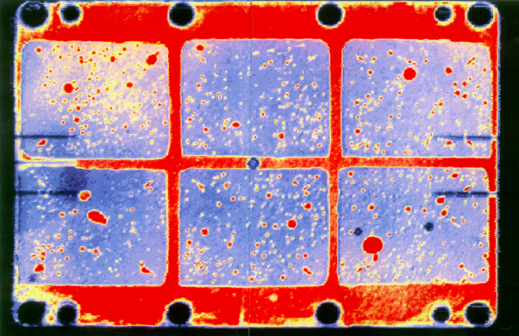
CTE-mismatch induced thermal fatigue in IGBT baseplate can be reduced by replacing Cu by AlSiC
Cu-baseplate
AlSiC-baseplate
as brazed
as brazed
Partial periferical delamination
after 24'000 cycles@ ΔT 50°C
No delamination
after 31'000 cycles @ ΔT 50°C
by courtesy of SIEMENS AG (G.Mitic)
Notes:
DCB: direct copper bonding

Slide 21
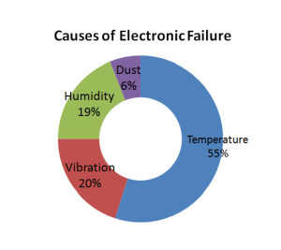
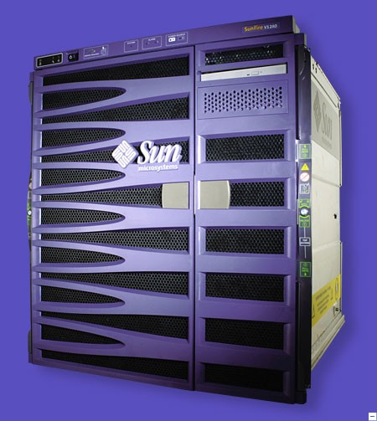
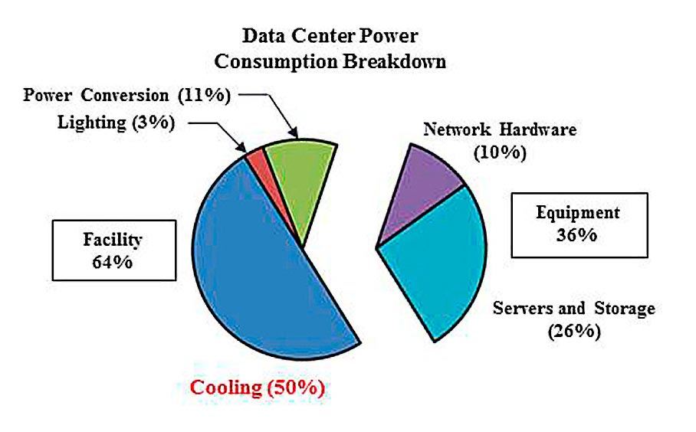
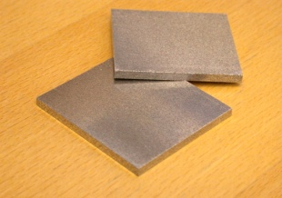

Aluminium composites for micro-electronic applications
Microelectronics:
Server for large scale data processing
Higher clock rates and miniaturi-zation of transistors lead to higher power density in micro-processors
Notes:
In Mikroelektronik- und Halbleiter-Komponenten verursachen die stetig zunehmenden Leistungsdichten einen derart starken Anstieg der thermischen Belastung, dass die kritische Temperaturgrenze gewisser Halbleiter-Komponenten bereits erreicht ist; demzufolge muss die Wärme effizienter abgeführt werden. Dies erfolgt über das Substrat, auf welchem die Mikroelektronik- und Halbleiterkomponenten aufgebaut werden.

Slide 22
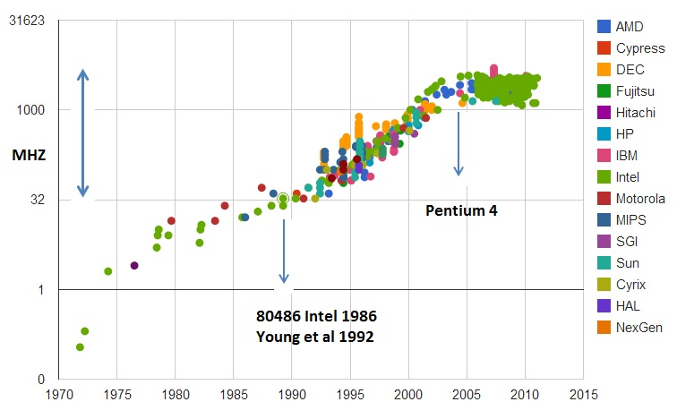
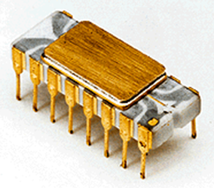
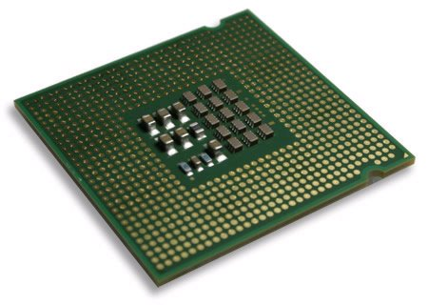
micro-electronic applications
Irwin&Vijay, PSU, 2002
CSE477 L01 Introduction.22
Lead microprocessors frequency evolution
after 2005 plateau reached at 5 GHz and 100 W/cm2
Clock frequency (MHz)
1971
1 MHz / 2250 transistors
Intel 4004
Years
2005
>3.5 GHz / >40 Mio. transistors
Intel Pentium 4 Extreme Edition

Slide 23
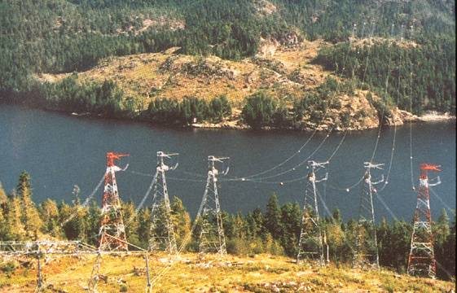

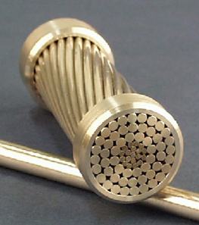
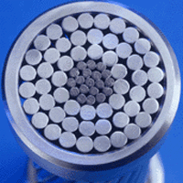
High-Capacity Overhead Conductors
source: 3M
Replacing steel cores by
material: AMC - Al/Nextel610/45f
tensile strength: 1200 MPa
density: 3.2 g/cm³
CTE: 6.6 10⁻⁶/K
electr. conduct.: 34 % IACS
Composite solution: similar strength; density reduced by 60%; CTE reduced by 50%; Thermal conductivity increased by 400%; electric current density increased by 200-300%
© 3M all rights reserved
Notes:
The need to delivery ever larger amounts of power, with the same reliability and performance customers have come to expect, is an ever increasing daily challenge. In addition, congestion and emergency capacity requirements are creating problems that the transmission grid was never designed to handle. One solution to these challenges is the use of 3M's Aluminum Conductor Composite Reinforced (ACCR) cable for your transmission line applications Designed with a core using a unique 3M Aluminum Matrix Composite material, ACCR has several unique features when compared to Aluminum Conductor Steel Reinforced, Aluminum Conductor Steel Supported and other commercially available and developmental or experimental cables. Tested in multiple field trials, ACCR in many applications will provide a benefit to you, the engineer responsible for power delivery by application of the cables many unique features. ACCR has a core material as strong as steel with lower electrical resistance and a coefficient of thermal expansion less than steel or aluminum. These improved properties allow you to design transmission lines capable of carrying up to 3 times the load of a standard cable, with less sag and few if any tower modifications. Convenient for everyday needs and ideal for long span or rugged terrain applications, ACCR is the quick and reliable solution to upgrading transmission line requirements.
comparison AMC vs steel core wires: service temperature 200-240°C; Problem: sagging due to larger CTE of steel and reduced electric voltage due to higher electr. resistivity of steel; similar strength; density reduced by 60%; CTE reduced by 50%; Thermal conductivity increased by 400%; electric current density increased by 200-300% source: http://www.mmm.com/market/industrial/mmc/

Slide 24
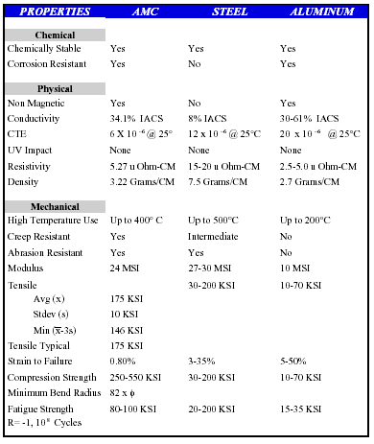
High-Capacity Overhead Conductors
Problem: sagging due to larger CTE of steel and reduced electric voltage due to higher electr. resistivity of steel
comparison AMC vs steel core wires:
service temperature 200-240°C
similar strength
density reduced by 60%
CTE reduced by 50%
Thermal conductivity increased by 400%;
electric current density increased by 200-300%
© 3M all rights reserved

Slide 25
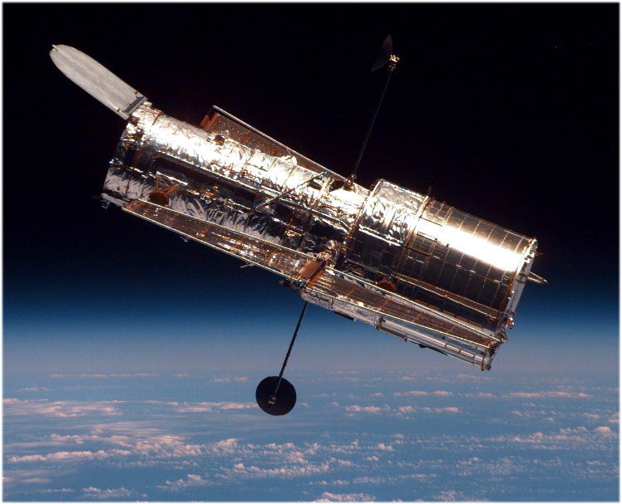
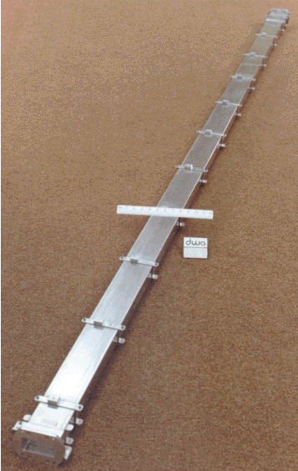
Hubble space telescope antenna waveguide mast
DWA
material: MMC - 6061/C-P100/42f
criteria: zero thermal distortion, resistant to atmospheric conditions in space

Slide 26
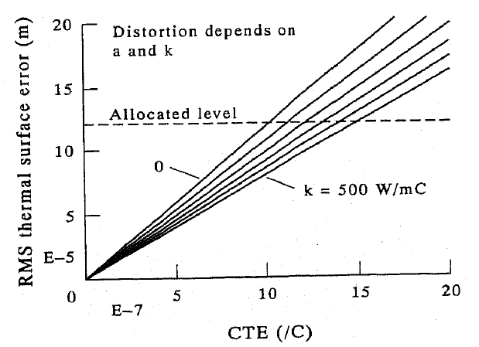
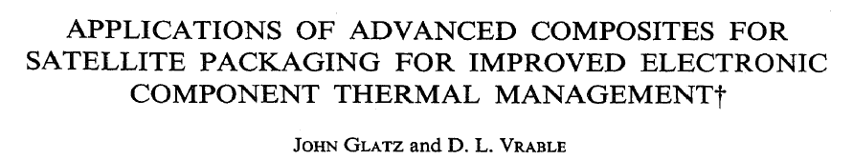
CTE and thermal conductivity requirements for satellite antenna structures
TC=0 W/mK, ->CTE max = 1.02 ppm/K
TC=500 W/mK, ->CTE max = 1.49 ppm/K
Dependence of imaging radar surface error on thermal expansion coefficient and thermal conductivity
Notes:
Thermal distortion of curved focusing and flat phased array antennas (and their supports) can have a significant impact on the transmitted power level and the accuracy of data received through them. This distortion is caused by 2 mechanisms. The first results from the uniform temperature change from a reference temperature and the second from internal temperature gradients. The variation in the temperature of the antenna structure can be a result of orientation with respect to solar radiation, shadowing, surface emissivity/reflectivity changes, etc. The dependence of imaging radar surface error on the CTEand TC under normal operating conditions is shown in the figure. Each solid line represents a fixed value of TC from 0-500 W/mK. A typically allocated error level for the thermal distortion is overlaid on the figure. If the effect of TC is neglected, the maximum absolute value of effective antenna strut CTE is 1.02 ppm/K. If the strut is constructed using materials and joining techniques having high TC, the requirement on CTE can be significantly relaxed. For instance, if the effective TC is 500 W/mK, the absolute value of the CTE may be as large as 1.49 ppm/K. This easing of the CTE requirements may be essential for applications of PMCs, MMCs or CMCs to precision satellite antenna structures.

Slide 27
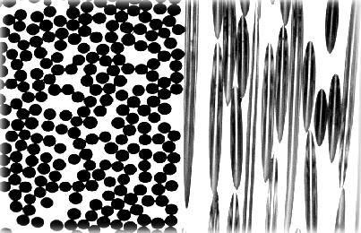
Hubble space telescope
antenna wave guide mast
continuous fibre
MMCs (CFRM) for zero thermal distortion
DWA
electrical
conductors

Slide 28
So what?
These examples illustrate the important role of composites in various thermal management applications for which no monlithic materials were suitable

